Slide 1




Final Project (BDAT 1001)
Task #2: Security Technologies Recommendations
By: Daryoush Shabahang
August 17, 2021, Presentation
Link to my private YouTube video: https://youtu.be/7eejMZKv1Jo

Slide 2


Introduction to Task #2
A local Hospital is asking me to act as a consultant on a project.
They have some questions that they hope I can answer.
Final Project Task #2 (BDAT 1001) – Daryoush Shabahang

Slide 3

About me
Daryoush Shabahang
Located in Toronto, Canada
Studying Big Data Analytics at Georgian College
Bachelor of Arts (with Honours) in Communication
Minor in Digital Media
Proficient in Excel, SQL, MS Office/Google Suite, Tableau, and Power BI with a bit of knowledge in Python programming.
Final Project Task #2 (BDAT 1001) – Daryoush Shabahang

Slide 4
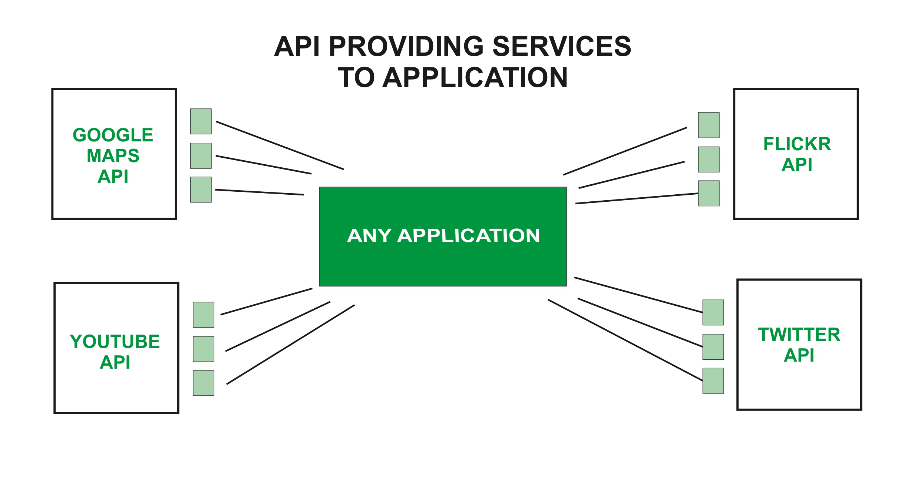
What is a Web API ?
API = Application Programming Interface
A Web API can be for either a web server or a web browser, and with ASP.NET, it’s used to build HTTP services for various platforms. Some of the examples include:
Final Project Task #2 (BDAT 1001) – Daryoush Shabahang

Slide 5

How can we transfer personal data securely within their network?
It is very important to not only be able to share and transfer data, but also to encrypt all personal data within your network in a timely and effective method – safeguarding the privacy of patients needs to be taken seriously.
There are actually multiple ways to encrypt data:
FTP provides anonymous access with three different modes of data transfer, and mainly used to transfer computer files. It’s not very secure, because it’s possible for anyone to access the data.
SFTP is an encrypted connection that requires an encrypted user ID and password to connect to a network that may have weak security. It transfers files with the Secure Shell (SSH) connection.
HTTP/HTTPS is great for data communication from the internet using the client-server computing model. The data is encrypted using TLS or SSL.
Try to not send data via email or on any Wi-Fi connections.
Final Project Task #2 (BDAT 1001) – Daryoush Shabahang

Slide 6
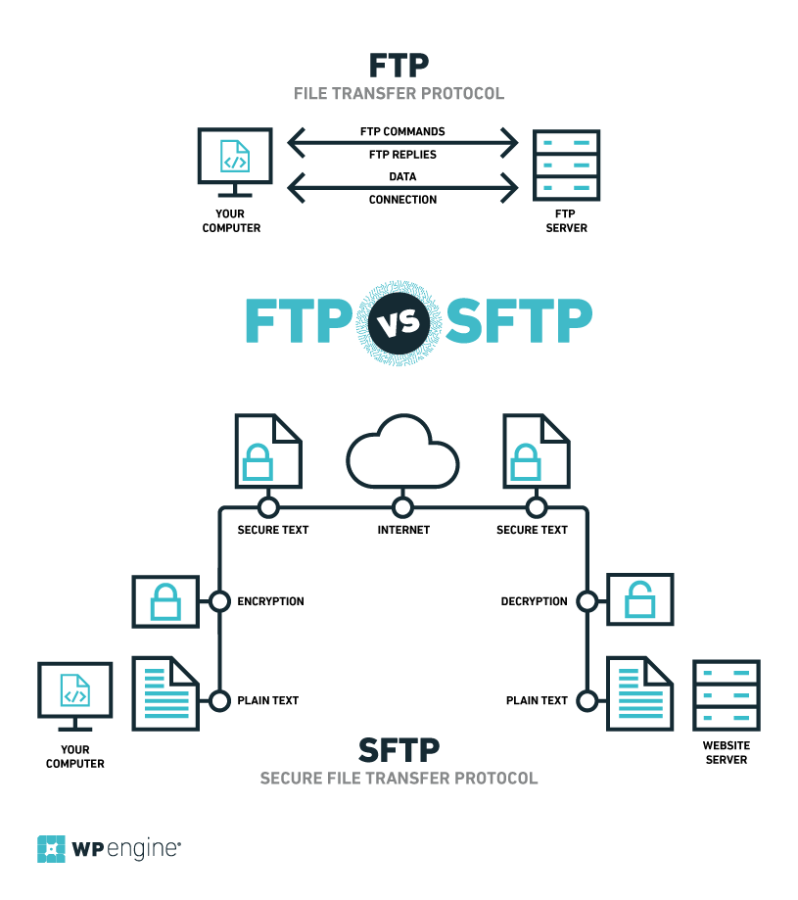
FTP vs. SFTP
Final Project Task #2 (BDAT 1001) – Daryoush Shabahang

Slide 7
What Privacy Policies should we be aware of before we get started? ○ Can you give us a checklist to follow?
There are a few privacy policies to consider and of course being open to obtaining user’s consent:
The Privacy Act
This act protects all personal information that the federal government collects, uses, and discloses, in addition to setting rules and limits on who can view and receive health information.
The Personal Health Information Protection Act (PHIPA)
This is the Canadian federal legislation and establishes rules to ensure the privacy and confidentiality of personal data while also saving time. PHIPA does not prohibit the transfer of personal information outside of Canada, but it’s very similar to the GDPR law in Europe (2016).
Final Project Task #2 (BDAT 1001) – Daryoush Shabahang

Slide 8
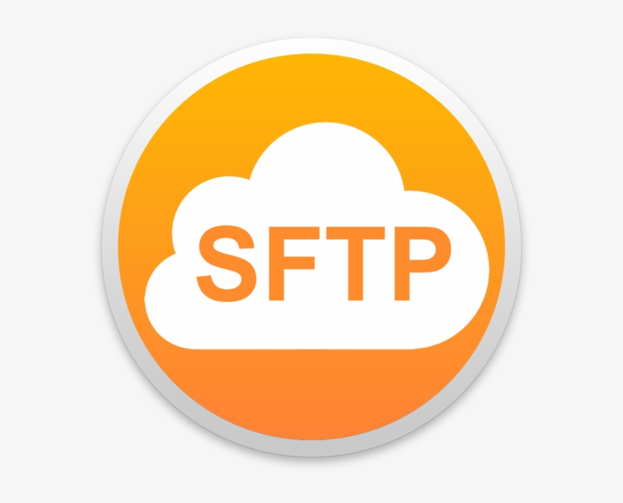
What security policy is best for transferring personal information?
SFTP (Secure File Transfer Protocol) is the best for transferring personal information. It’s an encrypted network protocol that can enable a remote login.
This type of protocol uses a safe dual authentication process that can protect passwords and sensitive data and prevents accidental transfers to unauthorized networks.
Final Project Task #2 (BDAT 1001) – Daryoush Shabahang

Slide 9

Can we encode and encrypt images?
Yes, we can encode and encrypt images, because text, images, audio, and video all communicate in 0s and 1s with computers – this is essentially data when we think about it. Encoding and encrypting can be used for various reasons i.e. copyrighting images and/or keeping images secured.
Encoding:
We can use Base64 to encode images into plain text encoding.
Encryption:
We can use special algorithm techniques like AES (Advance Encryption Standard) with ECB or CBC versions. Another technique is RSA (Rivest-Shamir-Adleman) to encrypt and even decrypt images.
Final Project Task #2 (BDAT 1001) – Daryoush Shabahang

Slide 10



AES encrypted image (examples)
Original image
ECB version
CBC version
Final Project Task #2 (BDAT 1001) – Daryoush Shabahang

Slide 11
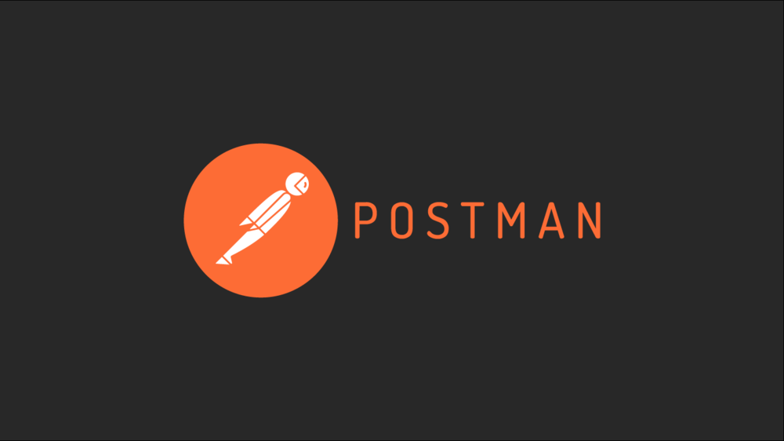
Our database cannot be moved from the site, and we need to be able to access it externally using a secure API ○ Can you explain the architecture of a secure API?
A secure API allows us to acquire data from a remote location, and REST API is the best for this.
We can request data from a database using these 4 methods:
GET – retrieves information about the resource
POST – creates a new type of resource
PUT – updates the resource
DELETE – deletes the resource at our preferred location
Postman is a really great app that is used for API testing. It can help connect to the API and test HTTP requests – plus, it’s fast and offers a free version!
Final Project Task #2 (BDAT 1001) – Daryoush Shabahang

Slide 12


Can you recommend a secure framework for coding an API?
The JWT (JSON Web Token) framework is frequently used and very secure, which relies on tokens and only correct credentials are permitted.
ASP.NET is also a popular web development framework for building web apps. It doesn’t require as much code which means it saves time and it has low maintenance.
Other great secure frameworks are Flask and Django modules using Python coding.
Final Project Task #2 (BDAT 1001) – Daryoush Shabahang

Slide 13
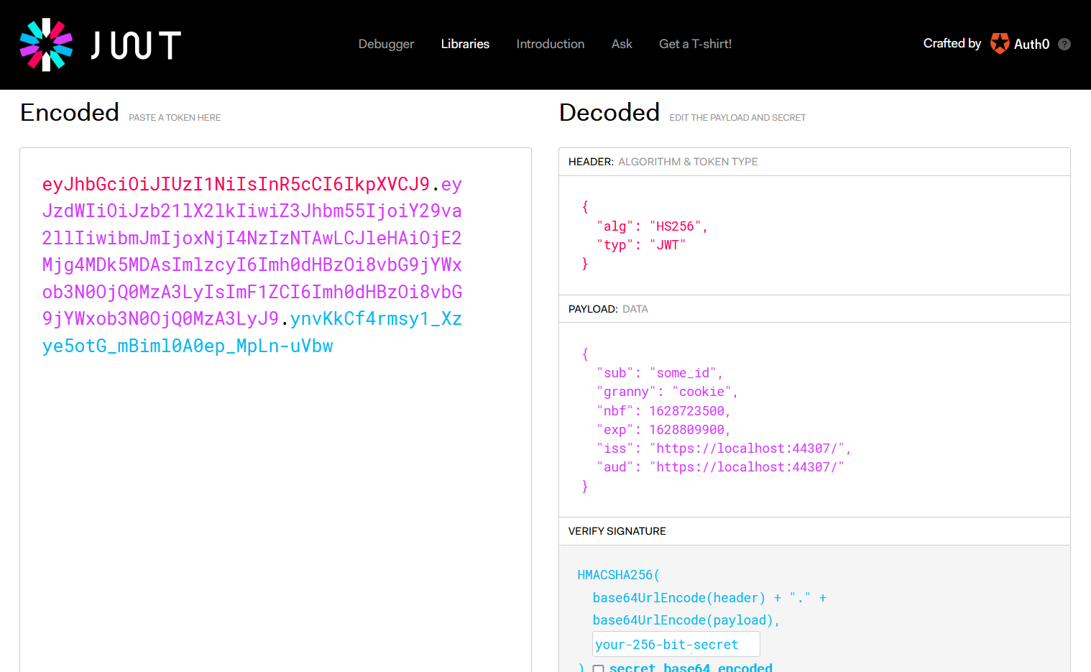
JWT framework example
Final Project Task #2 (BDAT 1001) – Daryoush Shabahang

Slide 14


What data interchange format should we use while transferring data between locations?
The best interchange format by far is JSON (JavaScript Object Notation) to send data between web servers and web browsers. Another format is XML (Extensible Markup Language).
JSON is easy to understand and even easy to use with No-SQL databases (i.e. MongoDB).
Both of them rely on key/value pairs and are known for relatively fast data transfers.
Final Project Task #2 (BDAT 1001) – Daryoush Shabahang

Slide 15
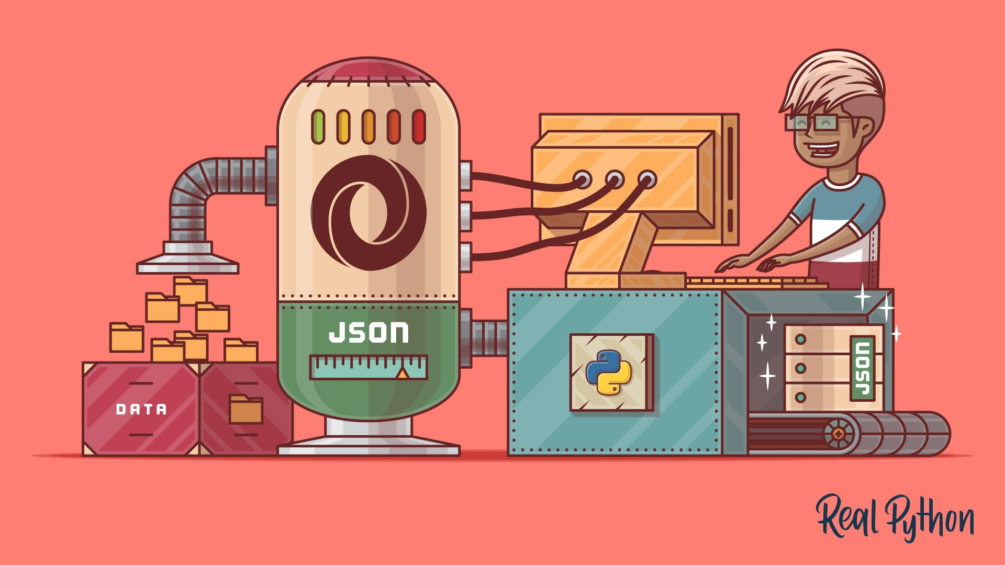
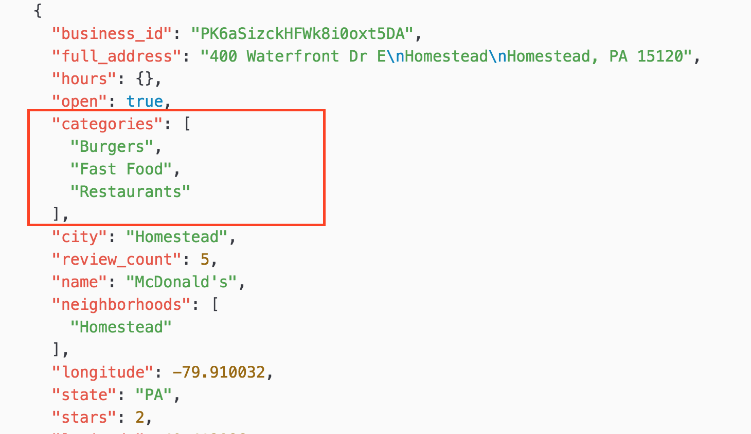
JSON example
Final Project Task #2 (BDAT 1001) – Daryoush Shabahang

Slide 16
How should we store our data in our many locations?
If you are storing data in multiple locations, then there are a couple things to consider, because it’s very important to always have a backup i.e. Hadoop always has three copies of the same data.
If you store data on the main server and access it through an API, then you don’t actually need to keep copies on everyone’s desktop since it’s not a very secure strategy.
Alternatively, you can use a software like FileZilla to access data from multiple locations. There are also virtual machines to use i.e. VMware or Oracle VirtualBox.
Private cloud storage is also increasingly becoming more popular and a great affordable option i.e. Amazon Web Services, Google Cloud Platform, Microsoft Azure, etc.
Final Project Task #2 (BDAT 1001) – Daryoush Shabahang

Slide 17

What are the ethical concerns related to the transmission of personal data?
There are a couple things to consider when it comes to ethical concerns:
It is important that companies ensure data confidentiality, integrity, and availability of their private data.
Hospitals and health care clinics have both a legal and ethical obligation to protect the privacy of patients, and ensuring the data does not get lost either.
i.e. Cancer Care Ontario lost colon cancer screening data of more than 7000 individuals.
Examples of consequences for a data leak includes:
Fraud and/or identity theft (i.e. 2017 Equifax data breach)
File tampering or removal
Legal penalties and/or fines
Final Project Task #2 (BDAT 1001) – Daryoush Shabahang

Slide 18
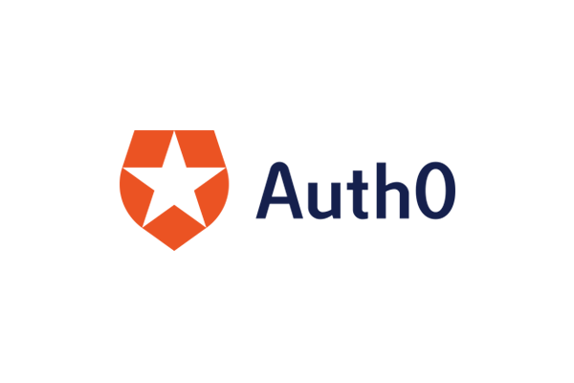
Make a recommendation on which choice of Authentication method (OAuth, OpenID, or other) is best for API security
The OAuth protocol is the best authentication method that is used to authorize clients attempting to access data from your server.
OAuth 2.0 requires specific tokens (i.e. JWT as a token) to protect and safely transfer data relying on server-side and client-side storage.
Final Project Task #2 (BDAT 1001) – Daryoush Shabahang

Slide 19

Thank You
I hope that you have enjoyed my presentation and learned something new to help with your hospital’s data security.
Link to my private YouTube video: https://youtu.be/7eejMZKv1Jo
Stay safe ☺
Final Project Task #2 (BDAT 1001) – Daryoush Shabahang

